Slide 1

Crystal Advanced Analytics
Milestone 3
Claudino Alves
Harshil Haumeer

Slide 2
Client: Dr. Richard Griffith Department of Psychology Faculty Sponsor:
Dr. Philip Chan
Department of Computer Science

Slide 3
Progress of Current Milestone
Task | Completion | Claudino | Harshil | To do
Implement, test and demo sentiment measurement of reviews (Sentiment analysis) | 100% | 0% | 100% | None
Implement, test and demo visualization of sentiment in different categories of hierarchy | 100% | 0% | 100% | None
Set up Website | 100% | 0% | 0% | None
Implement web-scrapper on website | 100% | 0% | 100% | None
Implement text classifier on website | 100% | 0% | 100% | None
Implement, test and demo benchmarking analysis tool | 40% | 0% | 40% | Research on benchmarking tool, and implementation

Slide 4
Discussion of each accomplished task for current milestone:
Task 1: Implementation of sentiment analysis
Analyzes reviews and assigns a score based on polarity
Polarity -1 to +1; more negative to more positive
Use of Textblob library
Task 2: Implementation of visualization of sentiment score
Graphs displays sentiment score for each category
Task 3: Implementation of Website
Back-end implemented on PyCharm IDE, Django and Django-REST Framework
Front-end implemented on Angular 2, HTML, CSS and JavaScript
Account settings implementation; Sign up and Sign In

Slide 5
Discussion of each accomplished task for current milestone:
Task 4: Implementation of Web-Scrapper on website
Provide reviews from social media platforms
Sorted by most recent reviews
Task 5: Implementation of text classifier on website
Reviews are automatically assigned their respective categories
NBC Classifier
Task 6: Implementation of Benchmarking tool
Comparison of MCO’s data to another Airport
Visualized through bar-charts

Slide 6
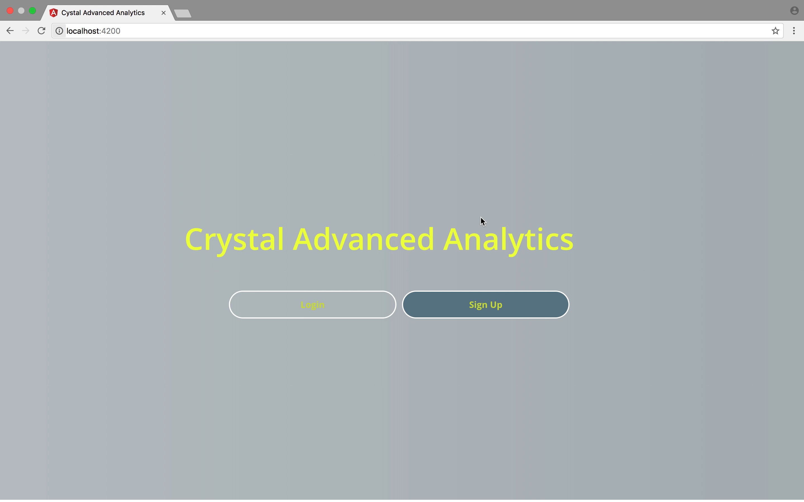
Demo : Website; Sign-up, Sign-in

Slide 7
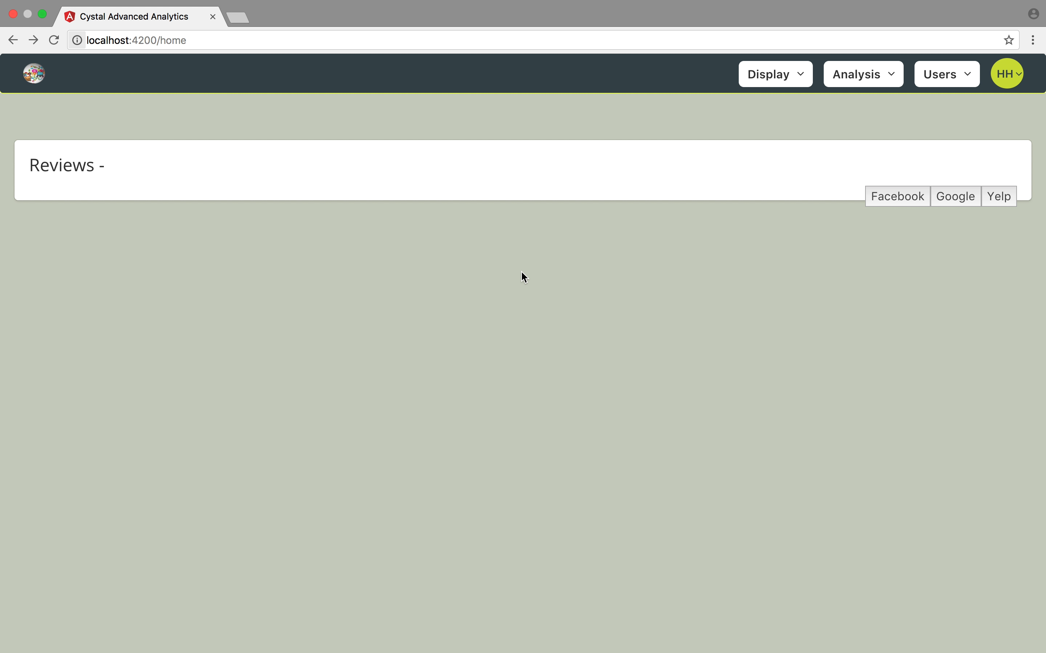
Demo : Website; Reviews and Categorization

Slide 8
Plan for Next Milestone
Task | Claudino | Harshil
Implement, test and demo benchmarking tool | 60% | 40%
Improve web interface | 0% | 100%
Implement sentiment analysis on website and implement drill-down feature | 50% | 50%

